Slide 1
Eurovision Voting Trends
Jake Simon
22 September 2021

Slide 2

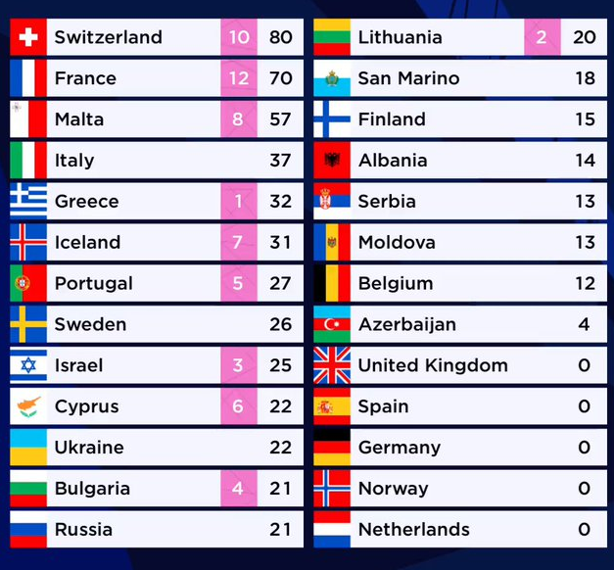
So Many Songs, So Few to Vote For!
The Eurovision Song Contest has a 2-tier voting system: jury and public televote
In each, voters pick their ten favorite songs, and assign 12 to their favorite, 10 to their 2nd, 8 to their 3rd, and 7-1 points for their 4th-10th favorites.
What do we want to know?
Does the running order affect a song’s point results?
As the contest has grown, more entries have been added to the contest each year.
As of 2021, there are 26 finalists, and 39 entries total!
Has this growth swayed the voters in any direction? Is it too much for them?

Slide 3






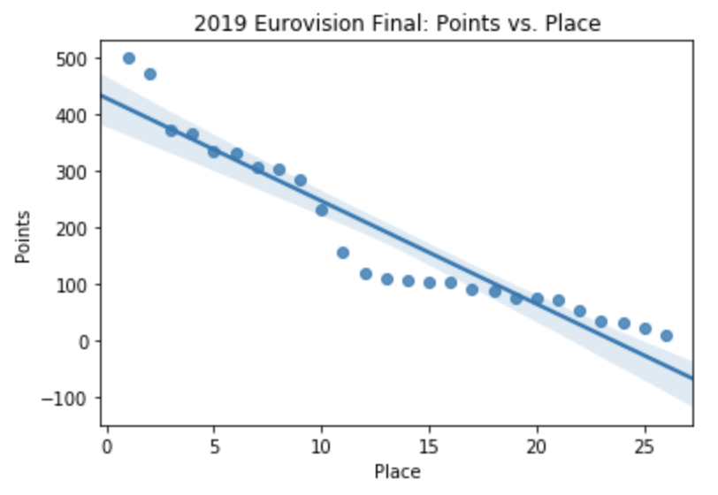
The Tools
How can we find this out?
We will use a linear regression model to detect positive or negative correlation as the order increases.
What will we use to fulfill this task?
R and RStudio
SQL (SQLite package via RStudio)
Python and its numerous statistical packages
I.e. Pandas, Numpy, Matplotlib, etc.

Slide 4

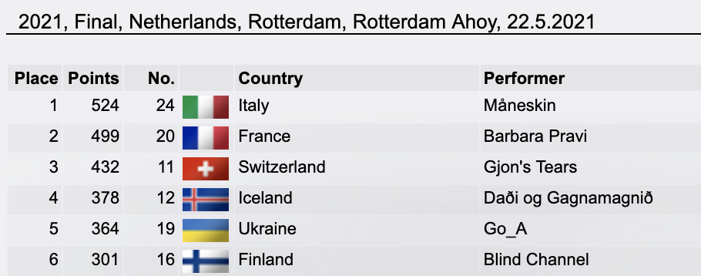
Let’s Collect the Data
Using eschome.net, we will download the “Results” of several Eurovision finals, starting with 2021.
After that, we will save the page as “HTML only” to our “html database”.
Once that’s there, we can now convert the data, using R and SQL!

Slide 5
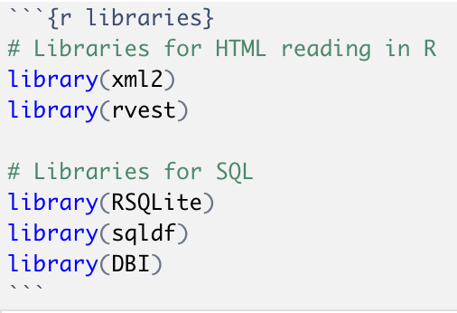
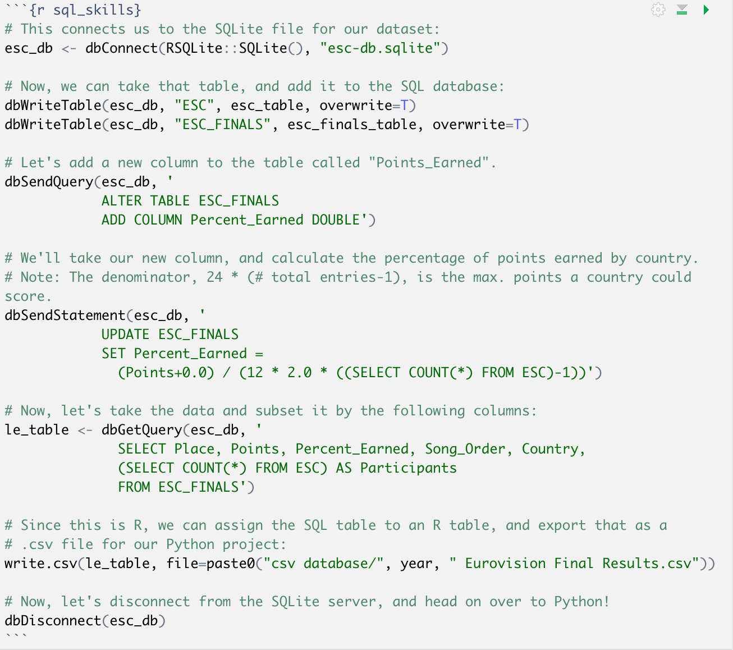
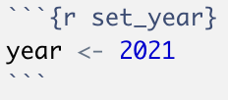
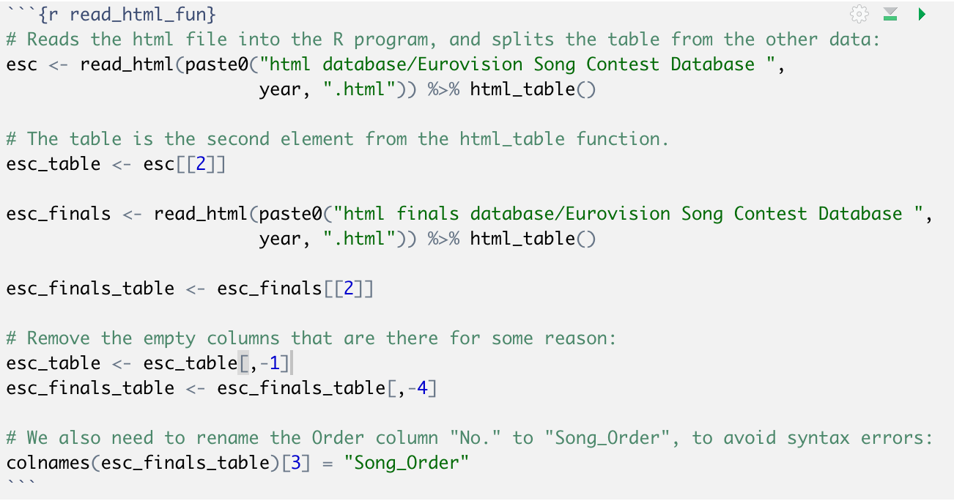
R and SQL: Converting and Cleaning the Data
The first step is to get the proper libraries. Once those are set, we can move on to the following steps:
Set the year.
Use SQL to select and modify columns, then use R again to write said columns into .csv file.
Convert the html files to tables, and clean data.

Slide 6
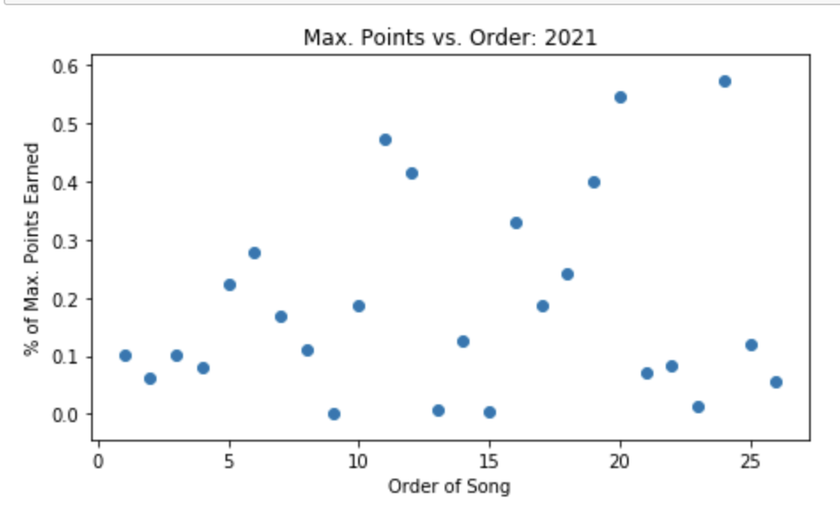
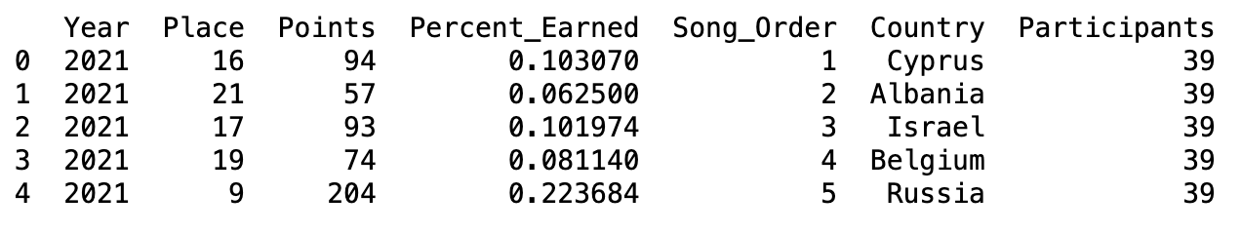
Python: What Does It Look Like?
Here is the head of the 2021 dataset, along with a scatter plot, comparing the final entrants’ points to their song order.
Pandas was used to create a DataFrame.
Matplotlib was used to create the graph.

Slide 7
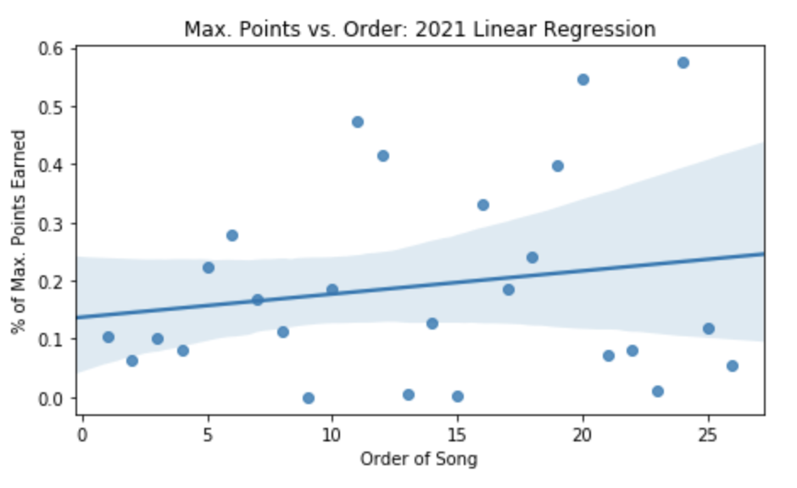
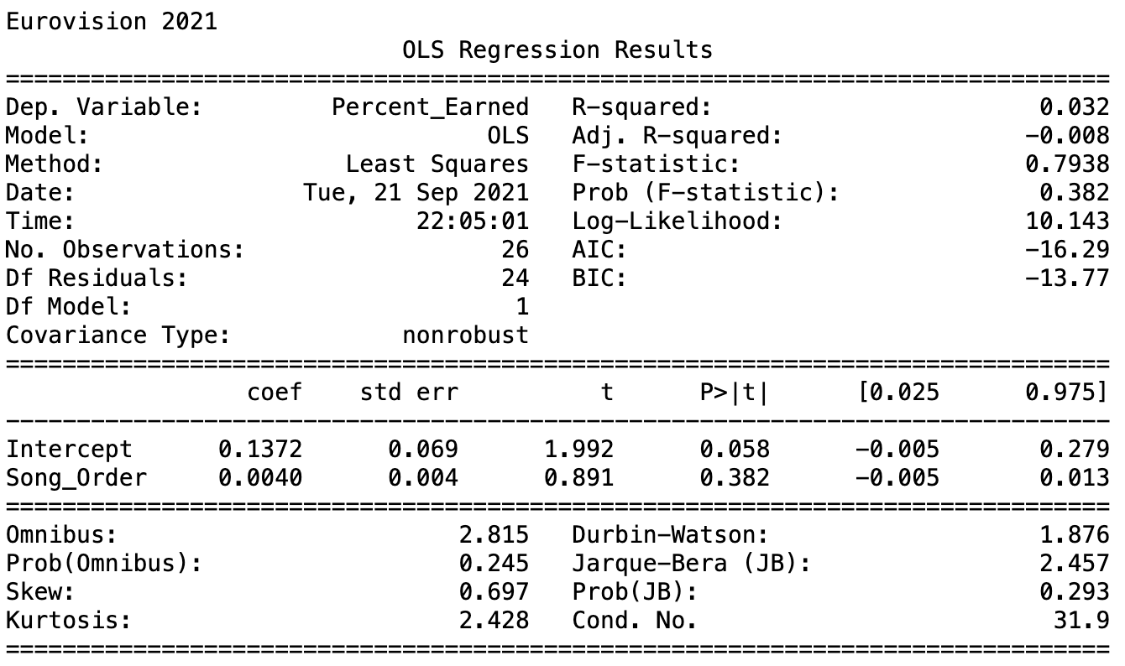
Regression Model: Does Song Order Affect Points?
Let’s see if the song order has any significant correlation with percentage of points earned:
The ‘regplot’ function is used to graph the data, while ‘ols.fit()’ is used to create the summary.
Turns out there is hardly any linear correlation, but there is still an interesting pattern as song order increases. It’s diverging!

Slide 8
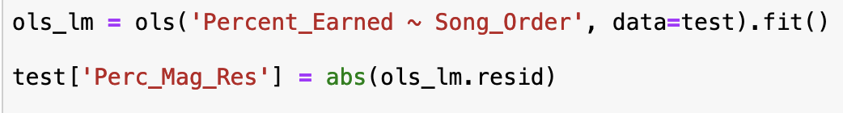
How to Make Sense of the Diverging Pattern
It appears to have a funnel-like shape, as the Order of Song increases.
How can we analyze this trend via regression?
Take the fitted model from before, and turn the point residuals as the new response!
Rather than a direct positive / negative correlation, we can now see if the points become less predictable over the course of the contest! (in other words, as the Order of Song increases)
We will take the residual’s absolute value to measure predictability. Lower value = more predictable

Slide 9
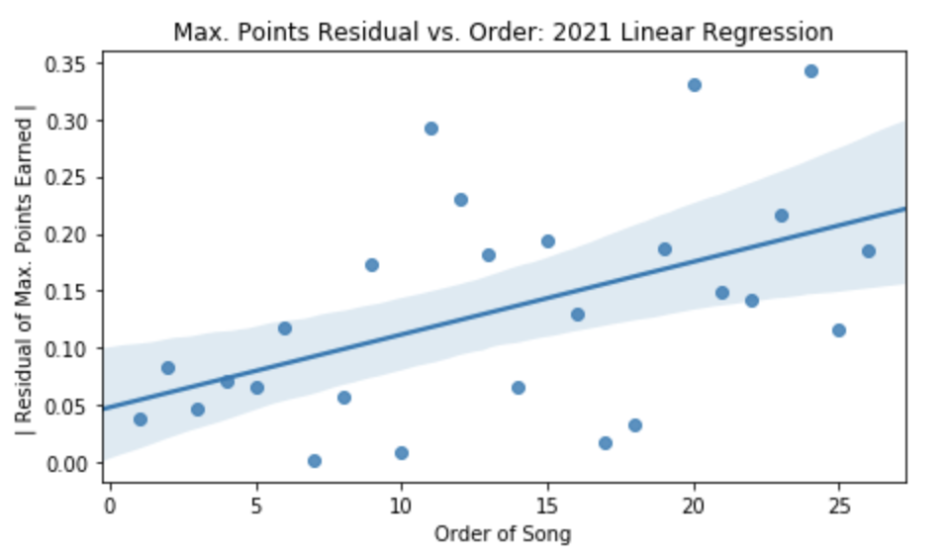
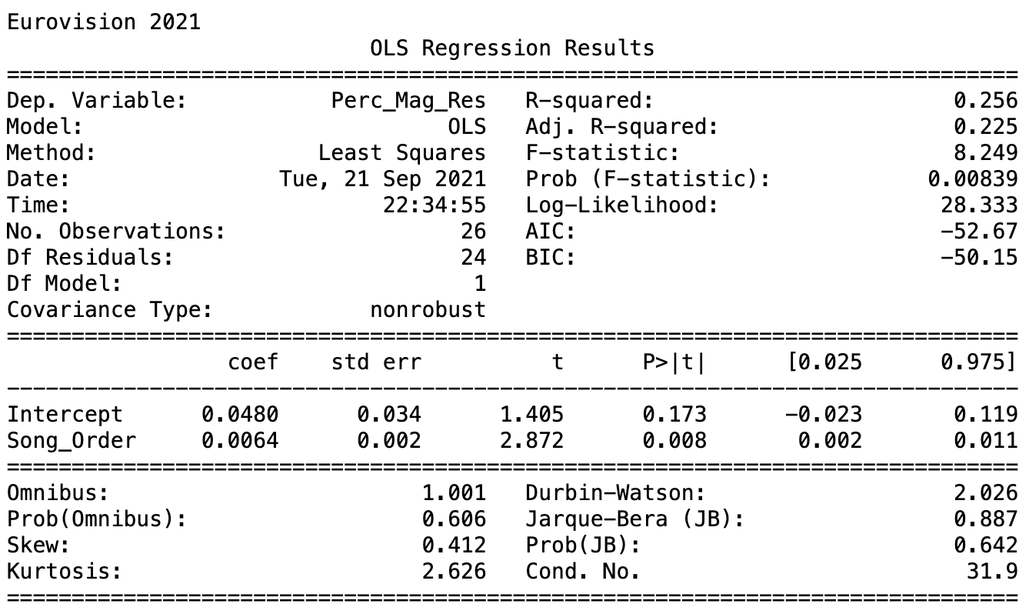
Residual Regression: How Does Song Order Affect Predictability?
Let’s take a look at the scatter plot, adjusted for residual magnitude.
This seems a lot closer to a significant correlation!
How does this impact the regression model’s fit?
Quite a lot actually! We can say with over 99% confidence, the further a song is in the contest (higher order), the less predictable its points become!

Slide 10

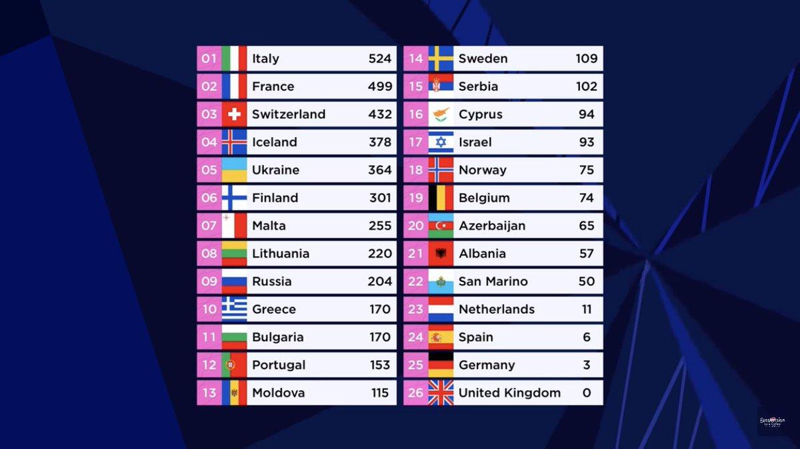
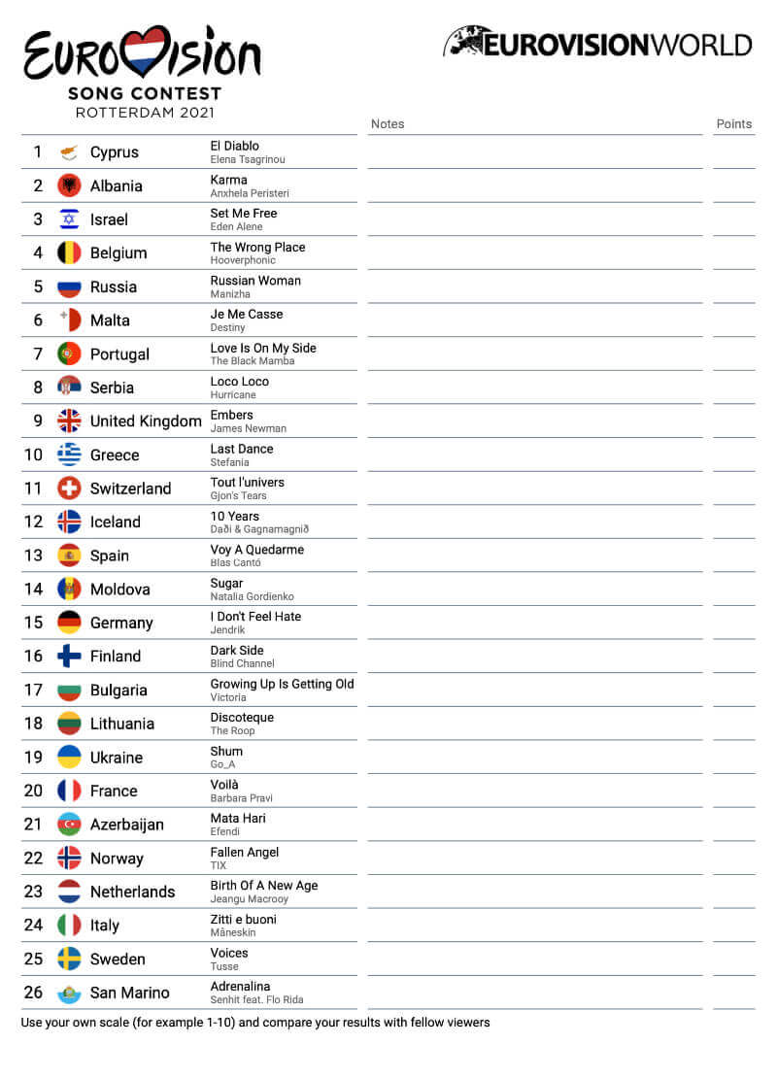

What does this finding mean?
Since the original regression model gets less accurate as song order increases, this could imply voters are a lot more fickle or judgmental towards later songs when they vote.
People could also tune out until the show gets closer to the results, causing them to pay more attention to the latter songs.
On the other hand, it could mean voters get disinterested as the contest goes along, and put less thought into who they vote for.
This seems less likely as it would imply all points would go down towards the end, which they did not, according to our first graph.

Slide 11
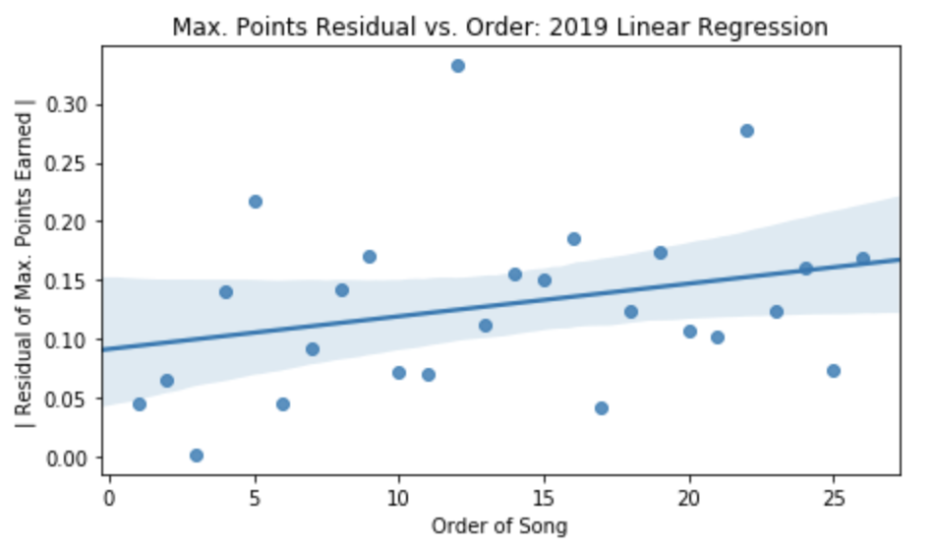
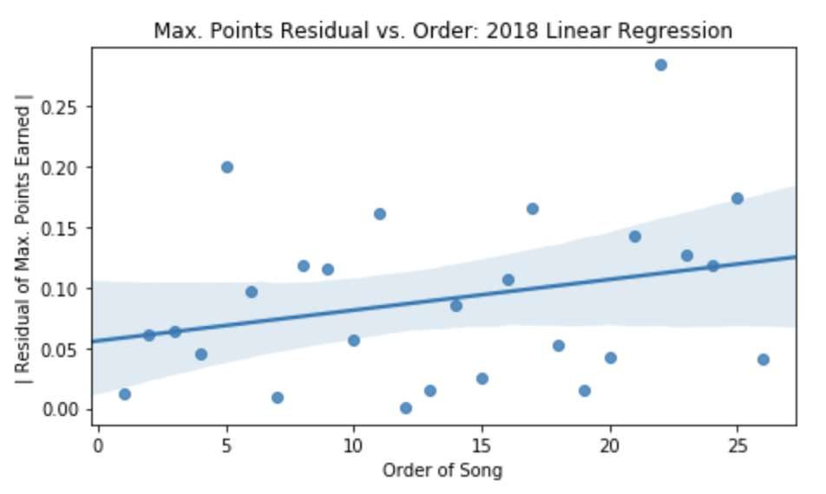
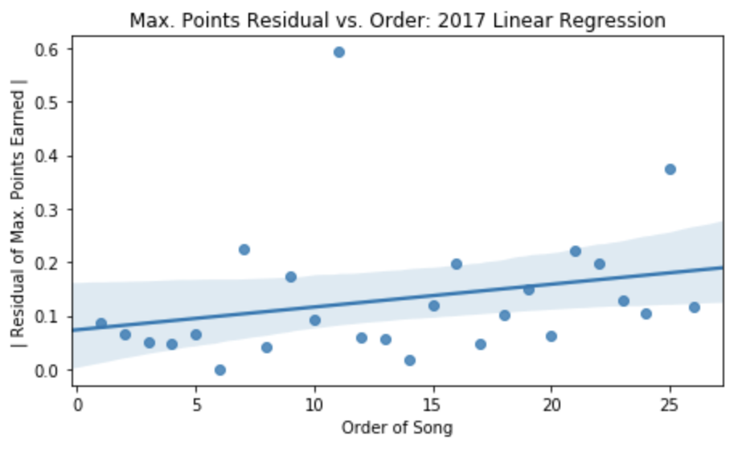
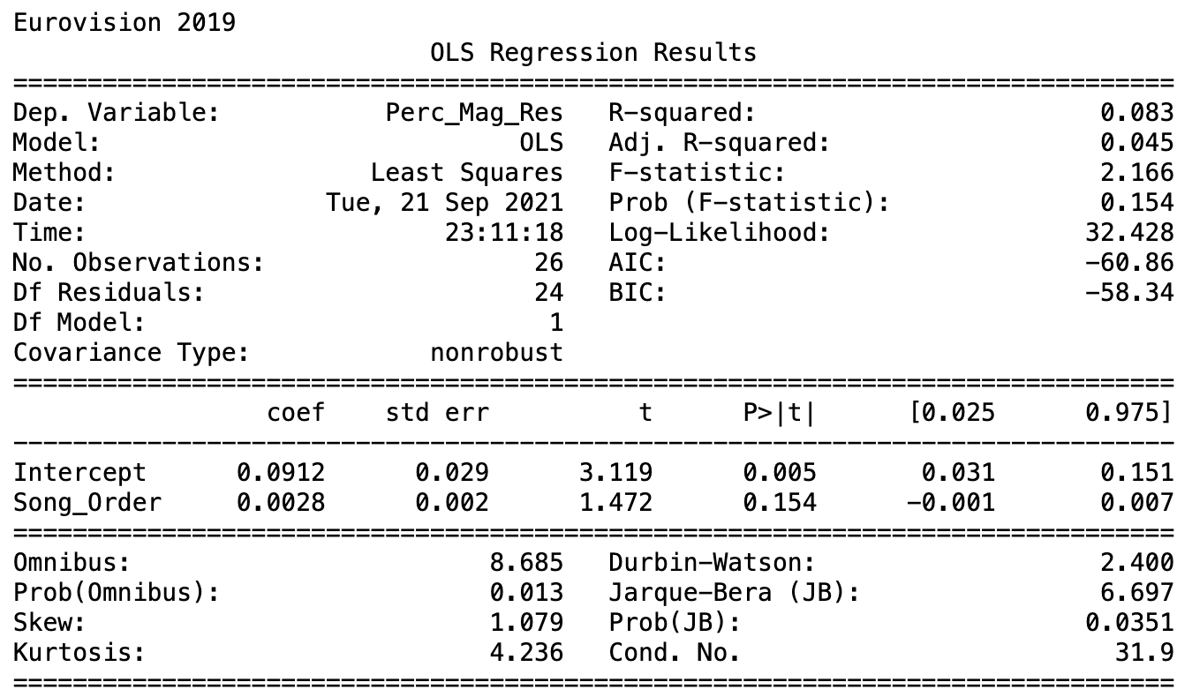
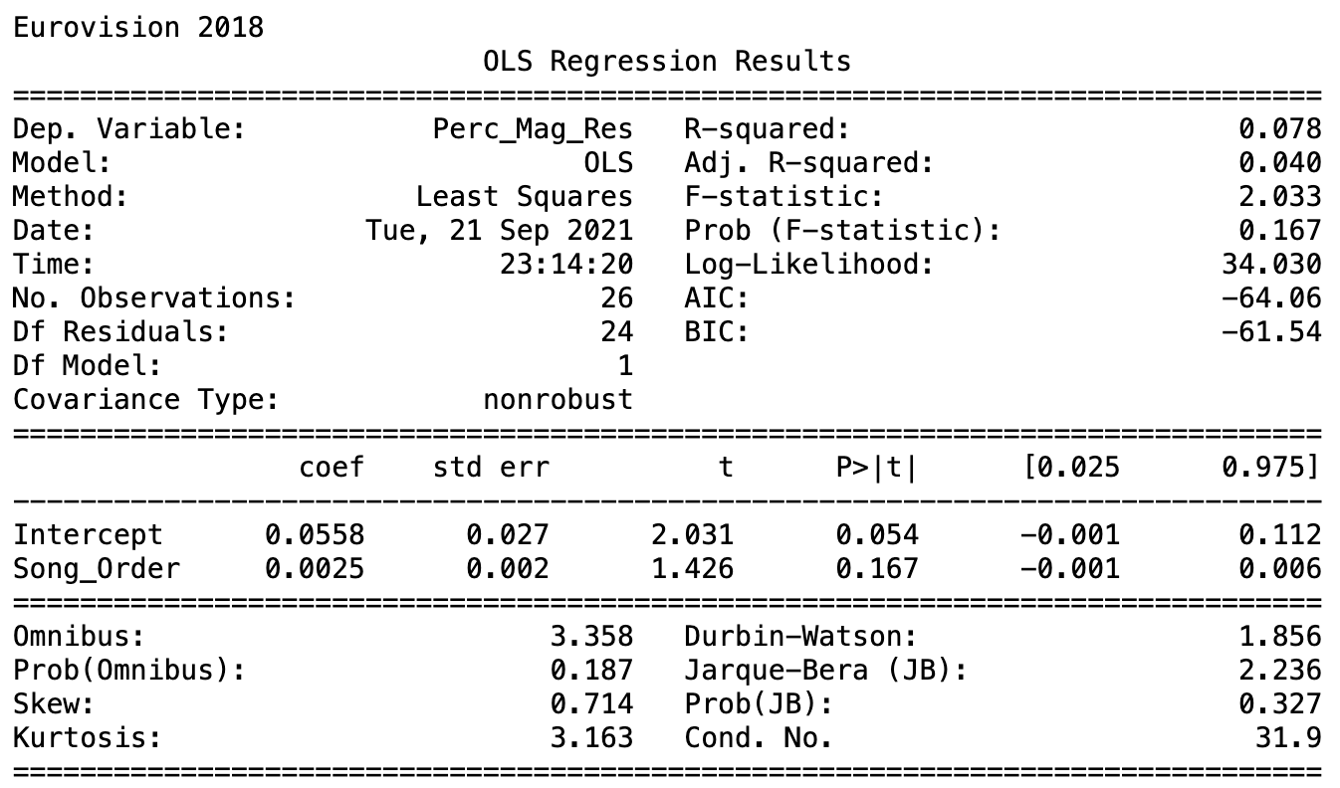
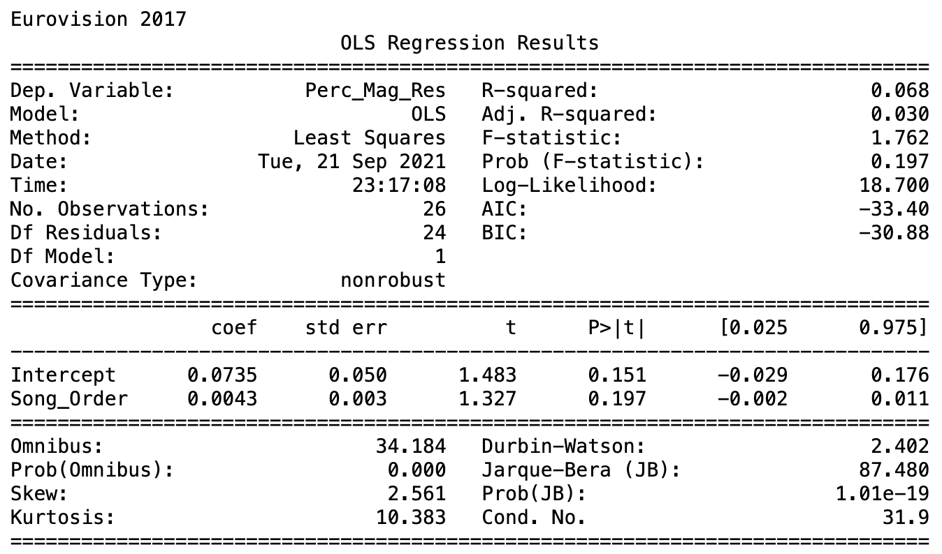
Was this a fluke one year?
Let’s take the previous three years, and measure their residuals.
2019: p-value = 0.154 2018: p-value = 0.167 2017: p-value = 0.197

Slide 12
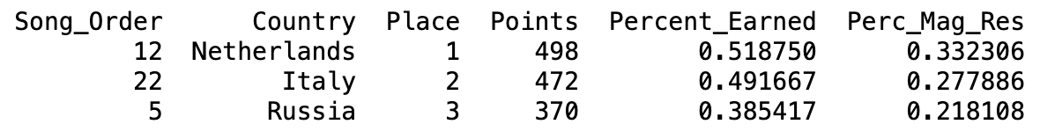
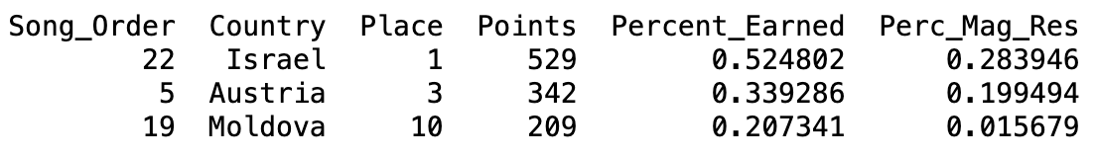
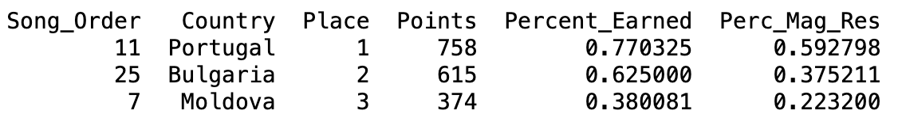
Maybe? Let’s remove the top 3 outliers per year.
Taking out the 3 songs furthest from the regression line removes any outstanding influence from singular points.
Although most points are within range of a positive correlation, the least accurate points (usually the songs with the most points) are in their own world mathematically and visually.
Now, let’s regraph the residual regression models! This should give us a more accurate reading of the data and its trends.

Slide 13
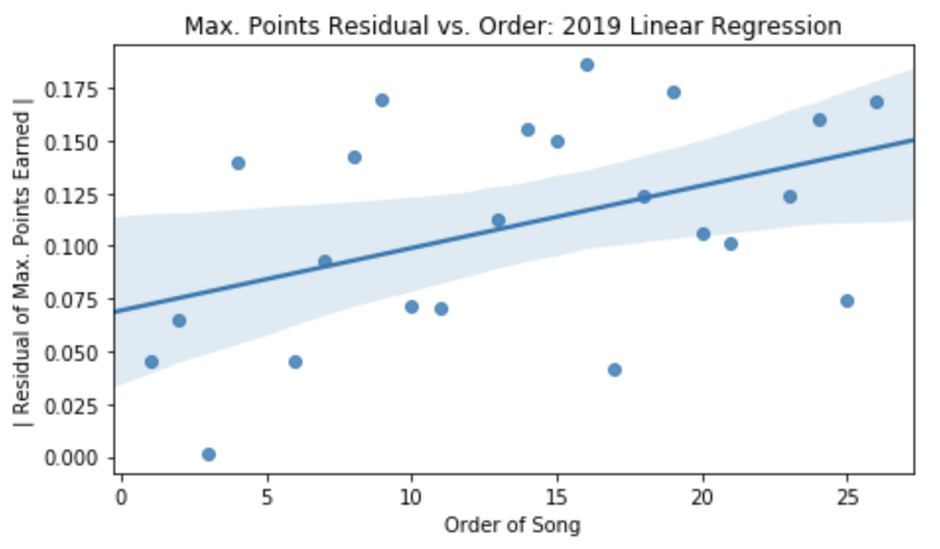
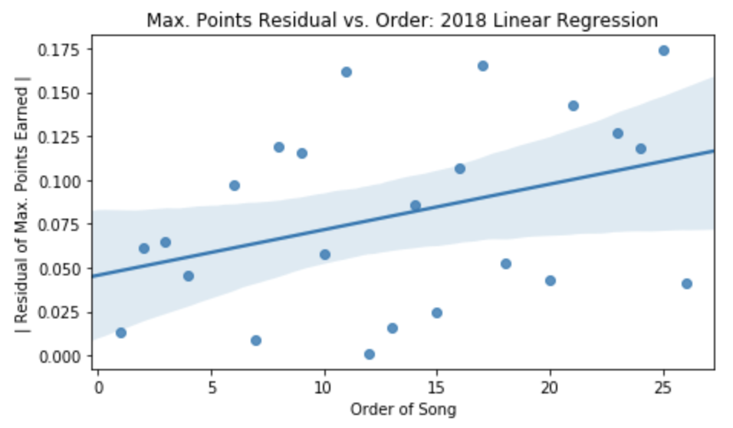
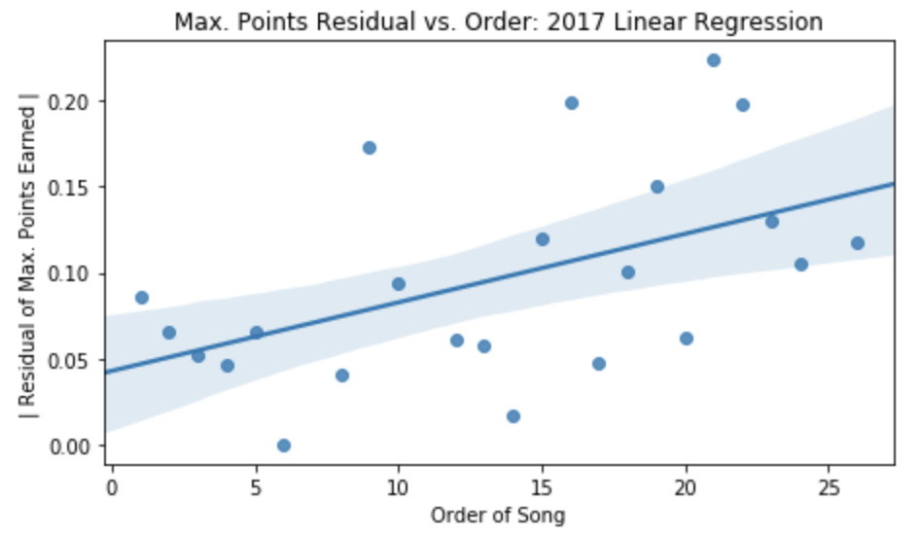



Now what do our regressions look like?
These are the regression models without their top 3 outliers.
2019: p-value = 0.031 2018: p-value = 0.081 2017: p-value = 0.014

Slide 14
Conclusion
Based on the previous three contests, 2021’s measurement of unpredictability seems to indicate a trend.
We can say with at least 90% confidence (96.9% excluding 2018) that later songs tend to vary greater and less predictably than earlier songs.
An interesting thing to note is that all four contests have had around 40 total participants each, and 26 final participants each.
Based on this logic of prediction, voters tend to be more sporadic with their voting later in the contest.
This could be attributed to later songs being more fresh in the voter’s head when recalling all the songs.
In the future, we can test this logic on older contests with fewer entries to see if the residuals and general distribution are less noticeable.

Slide 15
Links to My Programs and Repository
GitHub:
Project Repository: https://github.com/jakesimon2/ESC-Voting-Trends
This site contains all my code, data sources, and presentation slides.
Eurovision Song Picker (also on GitHub, created in 2020)
https://github.com/jakesimon2/Eurovision-Song-Picker
Thanks to eschome for keeping great track of all Eurovision Song Contests!
Link to Website, where I downloaded the data from: https://www.eschome.net/index.html

